Slide 1


Slide 2
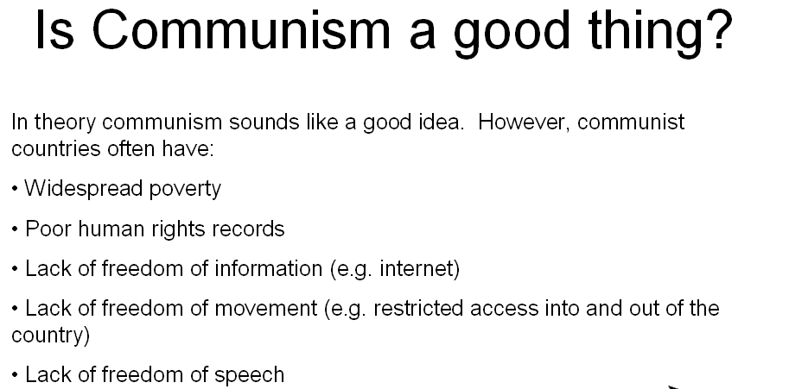

Slide 3
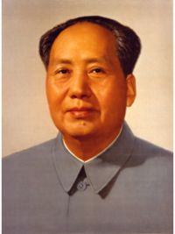
The Communist Party of China
The Chinese Communist Party (CCP) is ‘in charge’ of China
They control every level of government and are not open to sharing that power with opposing parties
With this said, there are a number of small parties that are ‘tolerated’
All levels of government are subordinate to the CCP (including the military and the courts)
CCP ideology is socialist = meaning that the Chinese government controls most of the production and distribution of goods
China is a socialist republic, in which politics are run by elected representatives who are all committed to socialist ideology
Although China became a communist country, it can no longer be classified as communist
Notes:
What is the meaning of “communism”?

Slide 4
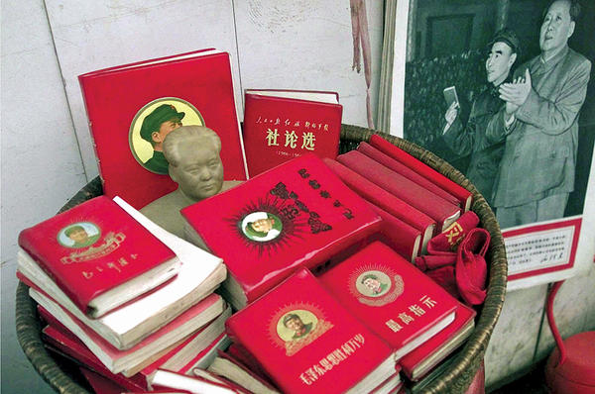
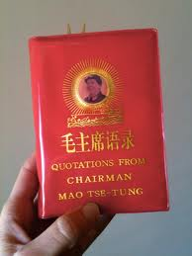
Power struggles followed – but in 1966 Mao led the Cultural Revolution . Everyone had to learn the leader’s quotes and sayings from his little red book and they constantly had to prove their loyalty to him - people who weren’t loyal were tortured or killed.

Slide 5
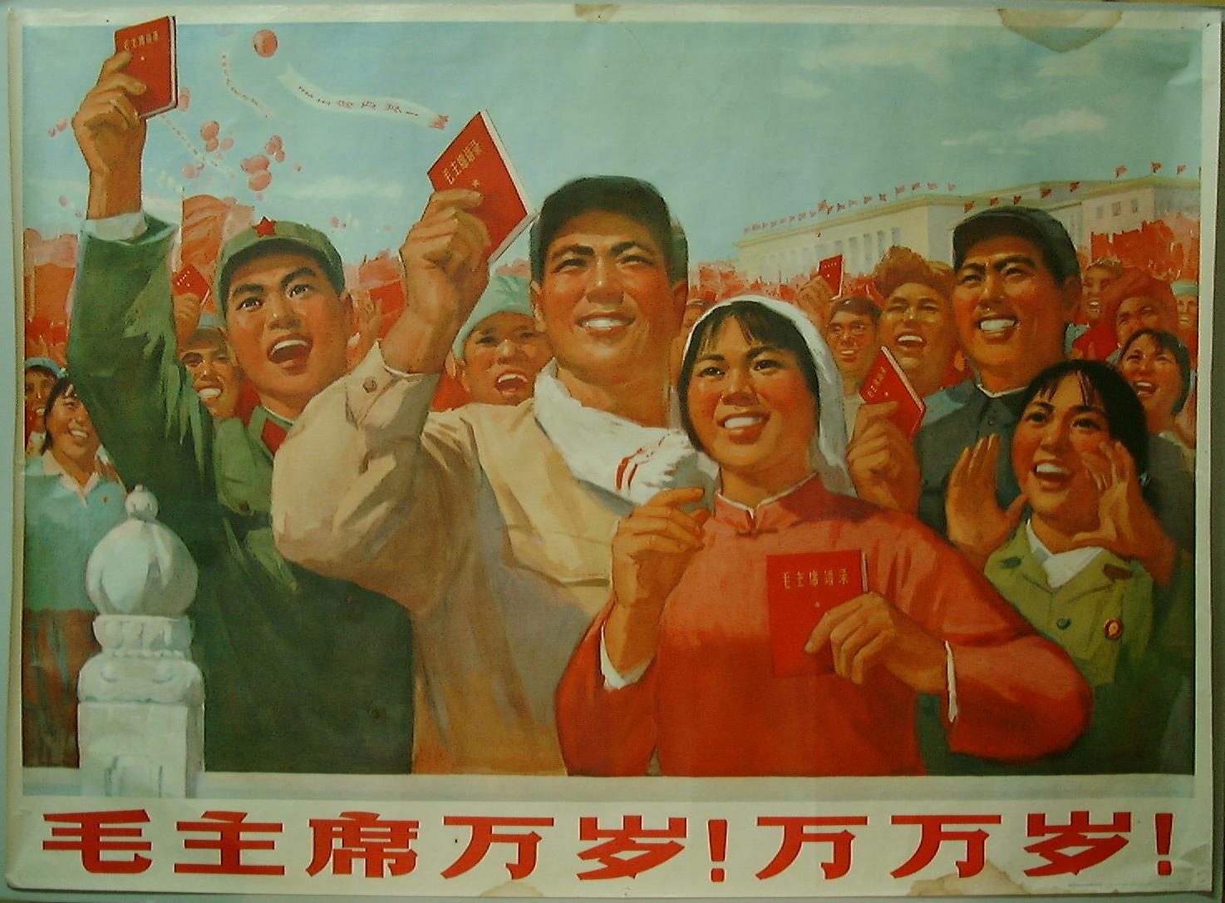

Slide 6
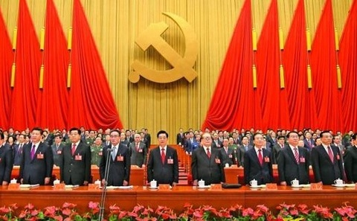
CHINA
One-party state ruled by the Chinese Communist Party (CCP)
The CCP has over 85 million members
The Chinese operates under 2 key areas:
The Party
The State
These 2 overlap as party members serve in the state

Slide 7
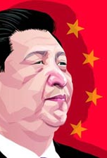
1. THE PARTY (CCP)
Under the Constitution, the Chinese Communist Party is the leading political party
The CCP controls citizens at all levels
Parliament is a unilateral legislature (only law-making body)
Theoretically this power lies with the National People’s Congress (NPC) however…
CCP is the real instrument of power
CCP meets every 5 years, the CCP Constitution is different to the State Constitution

Slide 8
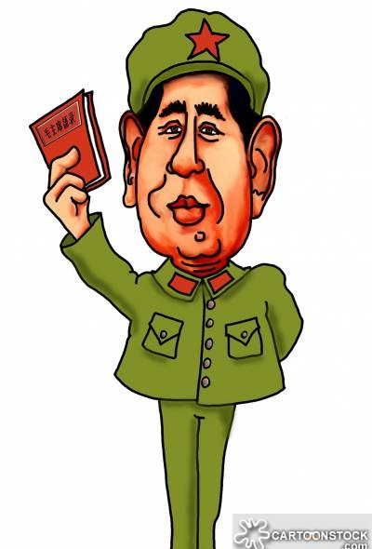
How to join CCP
Must be over the age of 18
Committed to party policy and programs
In 2011, 21.6 million applied and less than 15% accepted
Less than 25% are women
Members are organised into branches, which exist in all institutions and organisations (even private businesses)

Slide 9
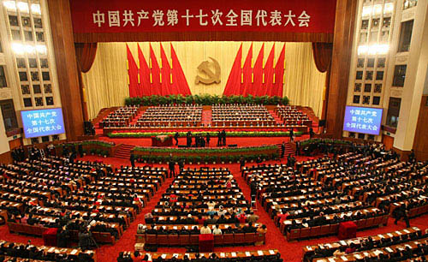
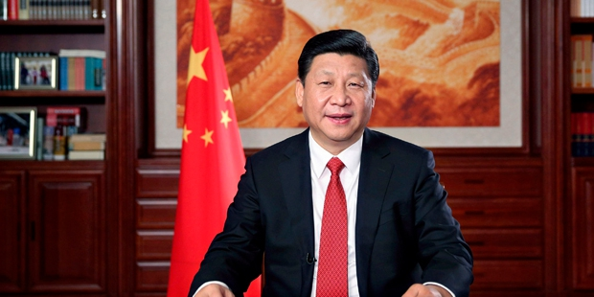
NPC (National Party Congress)
Every 5 years there is an election of a new committee.
Politburo Standing Committee selected (7 members)
Politburo are selected (25 members)
The Party Secretariat is also selected (day to day running of things)
The General Secretary is also chosen, who is the leader of the CCP (therefore leader of China – Xi Jinping)

Slide 10
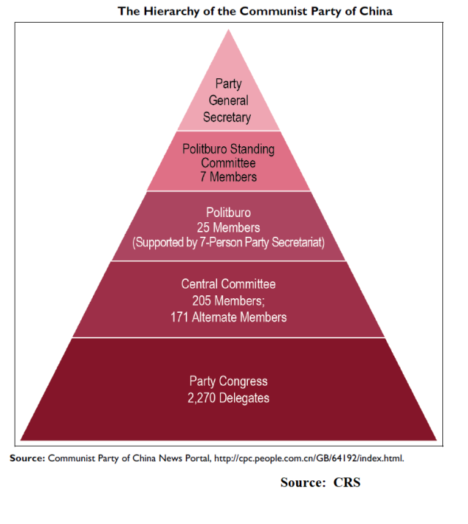
Structure of communist party
Politburo Standing Committee:
- Most senior body
- Spread ideology and propaganda
- Deals with corruption
- Oversees foreign policy
Poltiburo:
Represent party interests
Recruits/trains new party members
Controls all media, sets official message of Party
Deals with Supreme Court, justice and state security

Slide 11
https://www.youtube.com/watch?v=oHOkhAplfn0
https://www.youtube.com/watch?v=NgK8ZckweYw

Slide 12
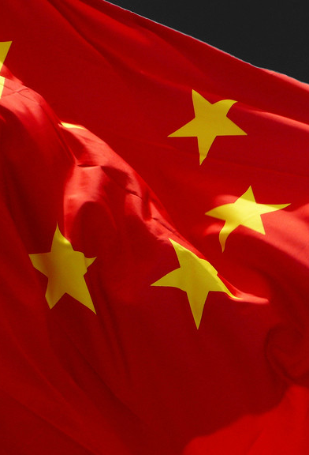
2. THE STATE
The State is not as powerful as the Party
Party members fill many of the committees and the roles within the State
Why?
So they can control all areas of public life

Slide 13
The State President (Govt)
This is China’s head of state
Who is also?
The General Secretary of the CCP
The party nominates the candidates for President and Vice-President, they are then elected by the NPC
However…the General Secretary outranks the NPC…so what does that mean?
The President: announces laws, appoints/dismisses government positions, receives foreign diplomats, signs treaties, announces emergency or declaration of war

Slide 14
The State Council (Govt)
Also known as Central People’s Government (CPG)
State Constitution – it is the highest organ of state administration
It officially implements CCP policies and enacts law passed by NCP
It also manages day-to-day admin of the economy
Similar to Cabinet is the sense that it has a vast array of organisations under its supervision
The Premier leads the State Council and is appointed by…
The President, who is?
The General Secretary of the CCP

Slide 15
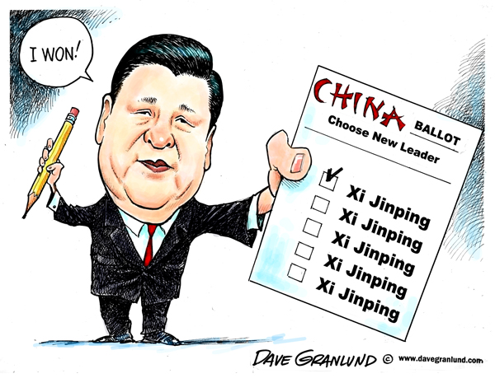

Slide 16
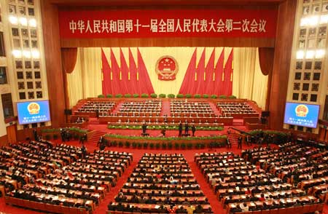
National People’s Congress (Govt)
‘Highest organ of State Power’
Enacts/revises laws
Proposes amendments to the Constitution
Ratify/annul treaties
Approve State Budget
Elect and dismiss top officials of state and judiciary
The CCP is the one in reality who fulfils these roles, the NPC is the body who approves Party decisions

Slide 17
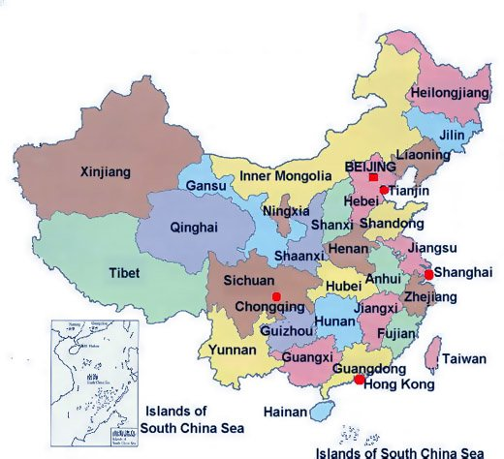
National People’s Congress (Govt)
The NPC meet for 10 days every year
They serve 5 year terms
Congress members are nominated by CCP and elected by electoral units (these represent provinces and regions throughout China)
Because the NPC don’t sit for long, the Standing Committee do most of the work, they meet every 2 months and has 161 members

Slide 18
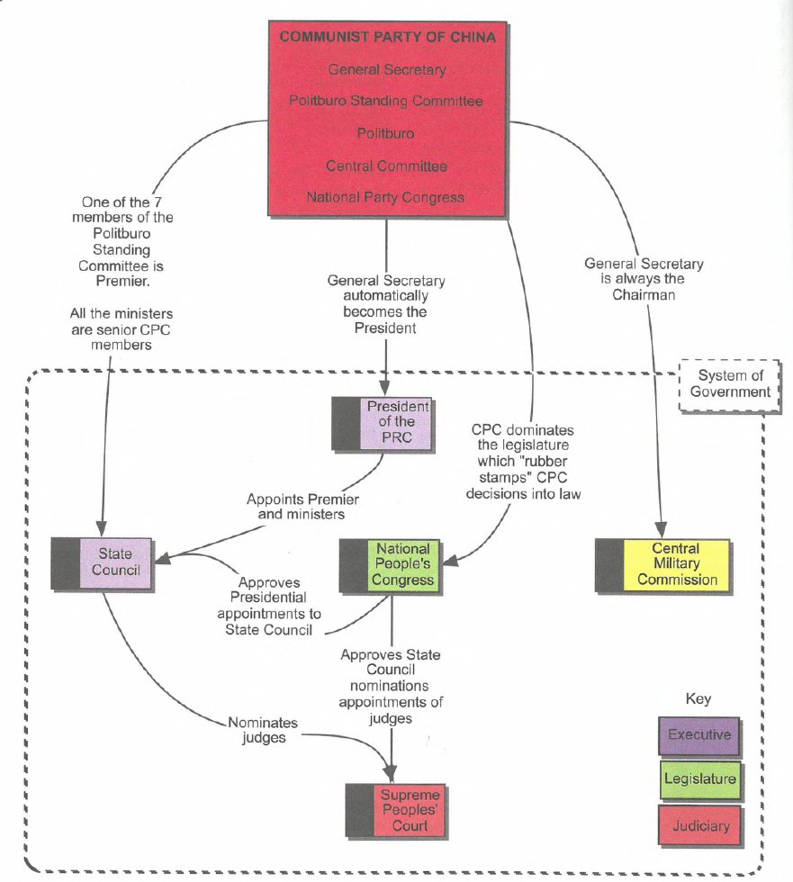
CHINA: SEPERATION OF POWERS?

Slide 19
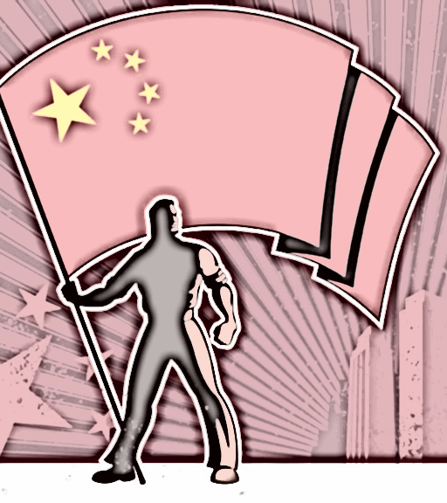
Minor Political Parties
8 in China
Must accept permeant leadership of CCP and cannot act as oppositions
They are there to show that China is a ‘multiparty cooperative system’
The heads of the parties can serve in NPC

Slide 20
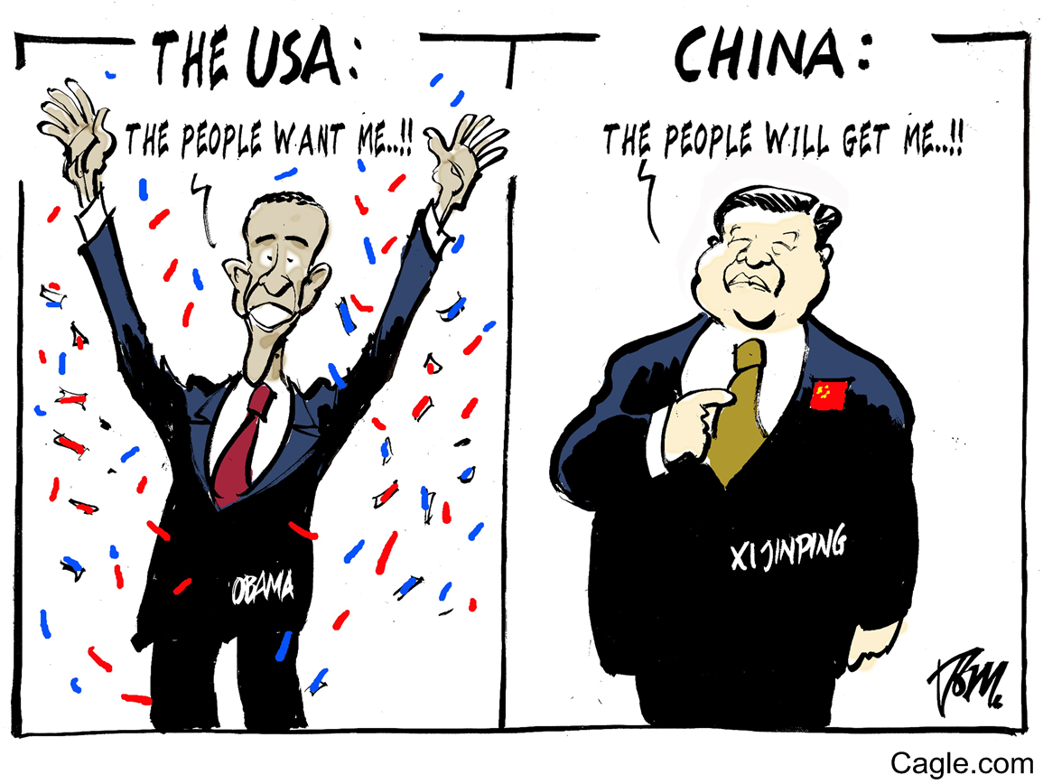
ELECTIONS IN CHINA
Given the size of Chinas population, elections are challenging
So the Party use voting at villages and local level
Electoral reform is slow as the party doesn’t want to give up control
Mix of indirect and direct voting

Slide 21
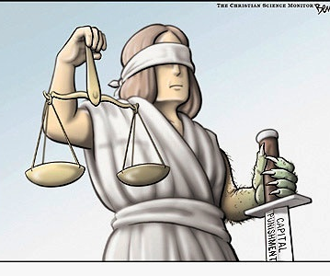
The Judiciary
Is the judicial system independent of the government?
Do fish like water?
The Supreme People’s Court is the highest court
Reports work to NPC.
The SPC functions:
Hears appeals
Approves death sentence
Discovers mistakes in other courts

Slide 22
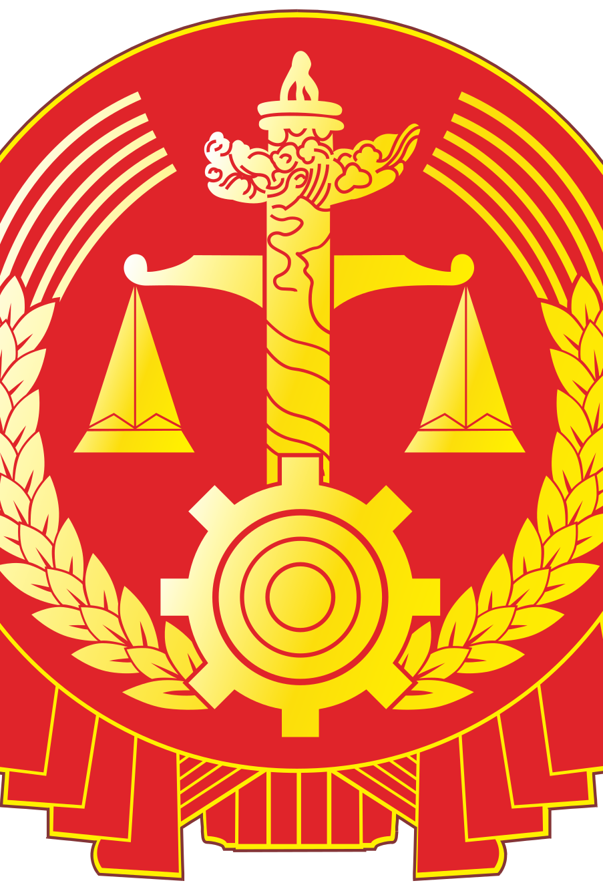
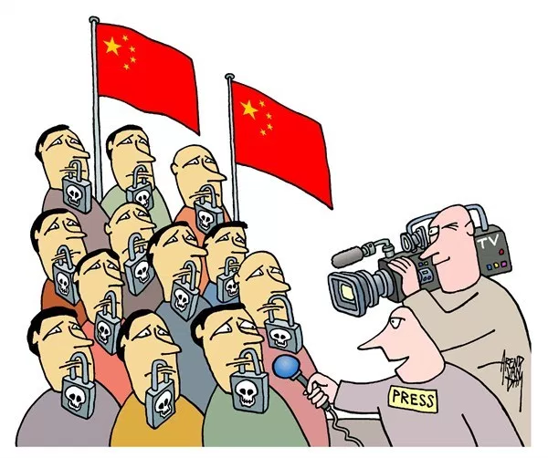
JUDICIAL BRANCH
The principles of the court are:
Equality
All people are equal before the law
Open trials
Trials are open, except those involving state secrets or the trials of minors
Defence
The accused is entitled to hire someone to defend them
System of collegiate panels
Panels consist of 1-3 judges and 2-4 people’s assessors
Appeal cases are heard by 3-5 judges. The panel is presided over by a judge
The system of challenge; and
In a conflict of interest, people can ask for the judicial officers to be removed
If a judicial officers feel they have a conflict of interest they need to withdraw
Independence in trials
Who appoints judges? …. NPC

Slide 23
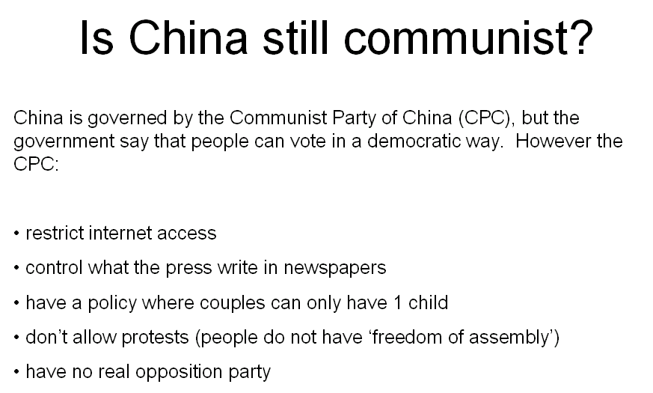
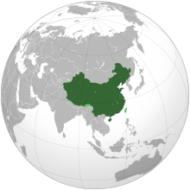

Slide 24
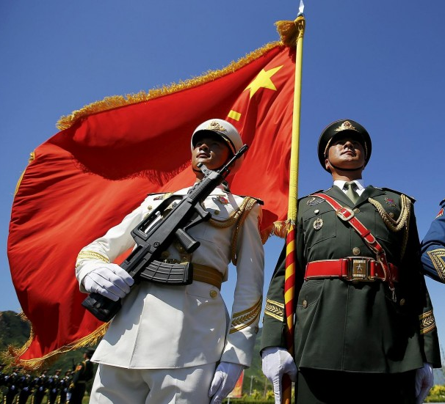
The People’s Liberation Party (PLA)
Central Military Commission exercises the command and control of PLA
However, this is supervised by the NPC…
Guess who the chairman of the PLA is….?

Slide 25
YAYYYY

Slide 26
RULE OF LAW?
The Party supports rule by law, NOT the rule of law…but what is the difference?
The Party is not subject to the confines of the law
Party commissions oversee police, prosecutors and the courts
They can intervene in matters to ensure that the party’s interests are met

Slide 27
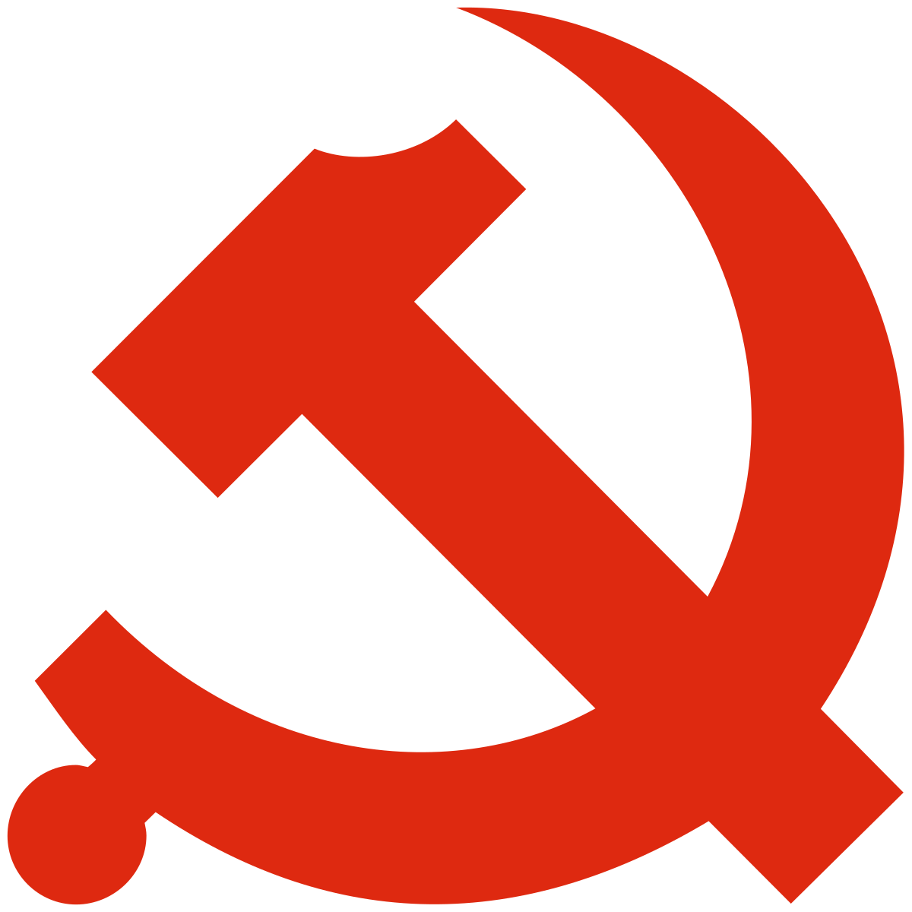
SUMMARY: HOW IS CHINA GOVERNED?
Three interlocking branches of power:
The Party Apparatus = Chinese Communist Party (CCP)
National Party Congress (2,270 delegates)
Central Committee (205 members; 171 alternate members)
Politburo (25 members – supported by 7-person Party Secretariat) = is dominant
Politburo Standing Committee (7 members) = is in control
Party General Secretary = Xi Jinping
The State Apparatus = Central People’s Government (CPG)
National Peoples Congress (NPC; approx 3,000 delegates)
Standing Committee (161 members)
Supreme People’s Court
Supreme People’s Procuratorate
The State Council
The State President = head of state = Xi Jinping
Peoples Liberation Army (PLA) = Armed forces
Central Military Commission
Chairman of CMC = Xi Jinping

Slide 28
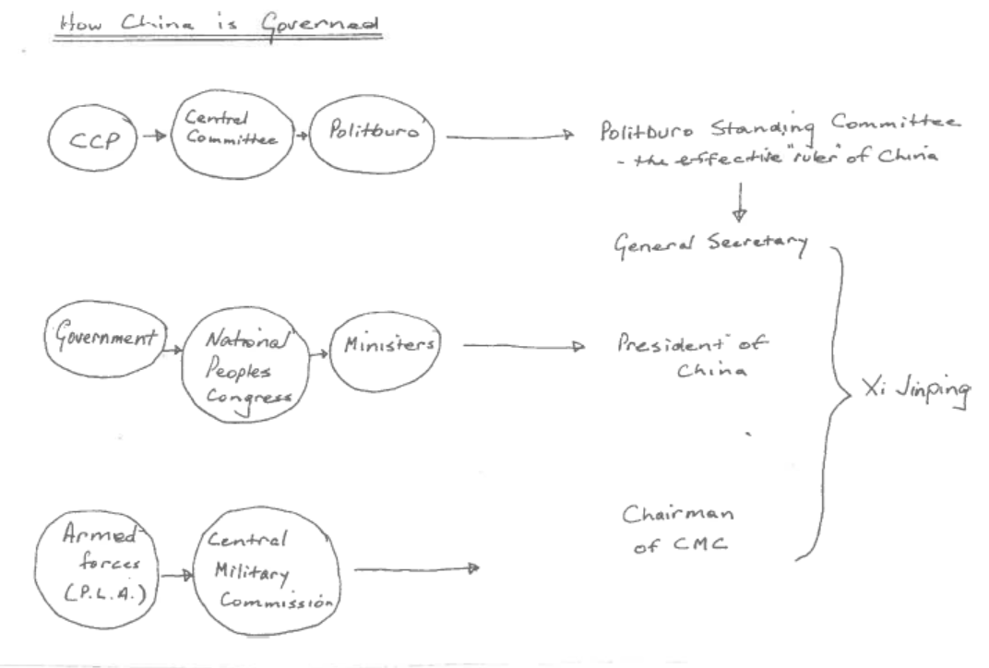
SUMMARY…

Slide 29
CHINA: SEPERATION OF POWERS?

Slide 30
SUMMARY..
Clearly the CCP has a monopoly on political power
The country lacks freedom of speech, an independent judiciary and other fundamental features of a democracy
https://youtu.be/fgor9fmA6po
https://youtu.be/oHOkhAplfn0

